Slide 1


IMPLEMENTAREA CONCURENTEI IN LIMBAJE DE PROGRAMARE
Simon Peyton Jones,
Beautiful Concurrency
PCPH, Cap. 10
S.Marlow
Software
Transactional
Memory
Ioana Leustean
atomically

Slide 2
Canale de comunicare: canale implementate cu MVar
readTChan
se blocheaza cand canalul este gol
writeTChan
nu se blocheaza
niciodata
import Control.Concurrent.STM
newTChan :: STM (TChan a)
writeTChan :: TChan a -> a -> STM ()
readTChan :: TChan a -> STM a

Slide 3
in IO cu MVar
type Stream a = MVar (Item a)
data Item a = Item a (Stream a)
data Chan a = Chan (MVar (Stream a)) (MVar (Stream a))
Canal in STM
type TVarList a = TVar (TList a)
data TList a = TNil | TCons a (TVarList a)
data TChan a = TChan (TVar (TVarList a)) (TVar (TVarList a))
TChan.hs ©2012, Simon Marlow

Slide 4
Canal in STM
data TChan a = TChan (TVar (TVarList a)) (TVar (TVarList a))
type TVarList a = TVar (TList a)
data TList a = TNil | TCons a (TVarList a)
newTChan :: STM (TChan a)
newTChan = do
hole <- newTVar TNil
read <- newTVar hole
write <- newTVar hole
return (TChan read write)
TChan.hs ©2012, Simon Marlow

Slide 5
Canal in STM
data TChan a = TChan (TVar (TVarList a)) (TVar (TVarList a))
type TVarList a = TVar (TList a)
data TList a = TNil | TCons a (TVarList a)
readTChan :: TChan a -> STM a
readTChan (TChan readVar _) = do
listHead <- readTVar readVar
head <- readTVar listHead
case head of
TNil -> retry
TCons val tail -> do
writeTVar readVar tail
return val
TChan.hs ©2012, Simon Marlow

Slide 6
Canal in STM
data TChan a = TChan (TVar (TVarList a)) (TVar (TVarList a))
type TVarList a = TVar (TList a)
data TList a = TNil | TCons a (TVarList a)
writeTChan :: TChan a -> a -> STM ()
writeTChan (TChan _ writeVar) a = do
newListEnd <- newTVar TNil
listEnd <- readTVar writeVar
writeTVar writeVar newListEnd
writeTVar listEnd (TCons a newListEnd)
TChan.hs ©2012, Simon Marlow

Slide 7
Canal in STM
main = do
c <- atomically $ newTChan
atomically $ writeTChan c 'a'
forkIO $ atomically (readTChan c) >>= print
forkIO $ atomically (readTChan c) >>= print
atomically $ writeTChan c 'b'

Slide 8
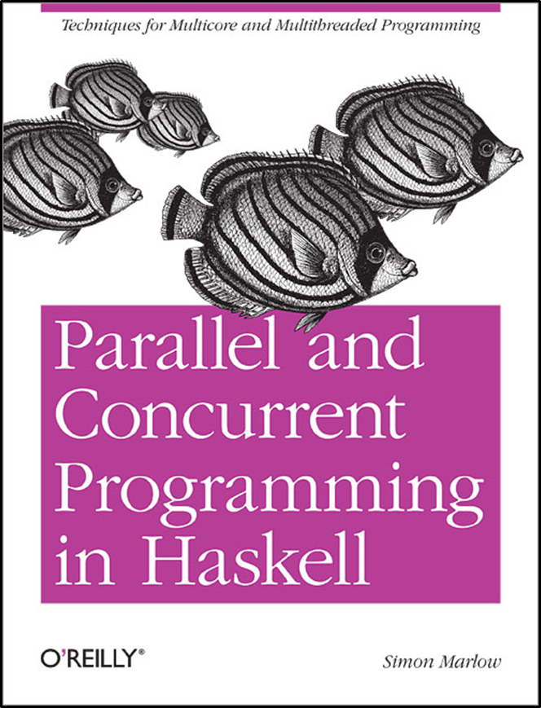

Implementarea unei
aplicatii de tip
SERVER
Part II. Concurrent Haskell
Cap. 12

Slide 9
System.IO
O data de tip Handle este o valoare extrasa
dintr-o actiune IO asupra fisierului curent
data Handle
"Haskell defines operations to read and write characters from and to files,
represented by values of type Handle. Each value of this type is a handle:
a record used by the Haskell run-time system to manage I/O with file system objects.
A handle has at least the following properties:
whether it manages input or output or both;
whether it is open, closed or semi-closed;
…
https://downloads.haskell.org/~ghc/6.2.1/docs/html/libraries/base/System.IO.html
https://hackage.haskell.org/package/base-4.18.0.0/docs/GHC-IO-Handle-FD.html

Slide 10
System.IO
O data de tip Handle este o valoare extrasa
dintr-o actiune IO asupra fisierului curent
data Handle
data Handle
type FilePath = String
data IOMode = ReadMode| WriteMode|
AppendMode| ReadWriteMode
hdl <- openFile "fis.txt" ReadMode
hclose hdl
https://hackage.haskell.org/package/base-4.18.0.0/docs/GHC-IO-Handle-FD.html

Slide 11
System.IO
import System.IO
exio1 = do
hdl1 <- openFile "f1.txt" ReadMode
hdl2 <- openFile "f2.txt" AppendMode
s <- hGetContents hdl1
putStrLn s
hPutStr hdl2 s
hClose hdl1
hClose hdl2

Slide 12
System.IO
import System.IO
exio1 = do
hdl1 <- openFile "f1.txt" ReadMode
hdl2 <- openFile "f2.txt" AppendMode
s <- hGetContents hdl1
putStrLn s
hPutStr hdl2 s
hClose hdl1
hClose hdl2
exio2 = do
s <- readFile "f1.txt"
putStrLn s
writeFile "f2.txt" s
readFile :: FilePath -> IO String
readFile name = openFile name ReadMode >>= hGetContents
https://hackage.haskell.org/package/base-4.18.0.0/docs/src/System.IO.html#readFile

Slide 13
socket
un socket (soclu) este un punct final in comunicarea
bidirectionala dintre doua programe din aceeasi retea
un socket are asociat un port
Client
https://docs.oracle.com/javase/tutorial/networking/sockets/definition.html
serverSocket <- socket AF_INET Stream 0
setSocketOption serverSocket ReuseAddr 1
bind serverSocket (SockAddrInet 4242 0)
listen serverSocket 2
SERVER
https://hackage.haskell.org/package/network-3.1.2.9/docs/Network-Socket.html

Slide 14


accept :: Socket -> IO (Socket, SockAddr)
Client 1
Client 2
Client 1
serverSocket <- socket AF_INET Stream 0
setSocketOption serverSocket ReuseAddr 1
bind serverSocket (SockAddrInet 4242 0)
listen serverSocket 2
socket-ul la care asculta serverul
SERVER
SERVER
(conn, _) <- accept sock
handleSock <- socketToHandle conn ReadWriteMode
clientul va scrie/citi folosind handleSock :: Handle

Slide 15
SERVER socket
main = do
sock <- socket AF_INET Stream 0
setSocketOption sock ReuseAddr 1
bind sock (SockAddrInet 4242 0)
listen sock 2
putStrLn "Listening on port 4242..."
loopForever sock
stabilirea conexiunilor CLIENT
loopForever :: Socket -> IO ()
loopForever sock = do
(conn, _) <- accept sock
handleSock <- socketToHandle conn ReadWriteMode
line <- hGetLine handleSock
putStrLn $ "Request received: " ++ line
hPutStrLn handleSock $ "Hey, client!"
hClose handleSock
loopForever sock
https://dev.to/leandronsp/a-crud-journey-in-haskell-part-ii-socket-programming-2po1

Slide 16
main = do
sock <- socket AF_INET Stream 0
setSocketOption sock ReuseAddr 1
bind sock (SockAddrInet 4242 0)
listen sock 2
putStrLn "Listening on port 4242..."
loopForever sock
Server
*Main> main
Listening on port 4242...
Request received: Ioana
Request received: Ana
loopForever :: Socket -> IO ()
loopForever sock = do
(conn, _) <- accept sock
handleSock <- socketToHandle conn ReadWriteMode
line <- hGetLine handleSock
putStrLn $ "Request received: " ++ line
hPutStrLn handleSock $ "Hey, client!"
hClose handleSock
loopForever sock
Client 1
C:\Users\igleu\nc>nc64 localhost 4242
Ioana
Hey, client!
Client 2
C:\Users\igleu>telnet localhost 4242
Ana
Hey, client!
https://dev.to/leandronsp/a-crud-journey-in-haskell-part-ii-socket-programming-2po1

Slide 17
main = do
sock <- socket AF_INET Stream 0
setSocketOption sock ReuseAddr 1
bind sock (SockAddrInet 4242 0)
listen sock 2
putStrLn "Listening on port 4242..."
loopForever sock
loopForever :: Socket -> IO ()
loopForever sock = do
(conn, _) <- accept sock
handleSock <- socketToHandle conn ReadWriteMode
line <- hGetLine handleSock
loopClient handleSock -- interactiunea cu clientul
loopForever sock
Handle pentru client

Slide 18
main = do
sock <- socket AF_INET Stream 0
setSocketOption sock ReuseAddr 1
bind sock (SockAddrInet 4242 0)
listen sock 2
putStrLn "Listening on port 4242..."
loopForever sock
loopForever :: Socket -> IO ()
loopForever sock = do
(conn, _) <- accept sock
handleSock <- socketToHandle conn ReadWriteMode
line <- hGetLine handleSock
loopClient handleSock -- interactiunea cu clientul
loopForever sock
loopclient handleSock = do
line <- hGetLine handleSock
if line == "end"
then do
hPutStrLn handleSock ("Good bye!")
hClose handleSock
else do
putStrLn $ "Request received from: " ++ line
hPutStrLn handleSock $ "Hey, client!"
loopclient handleSock

Slide 19
main = do
sock <- socket AF_INET Stream 0
setSocketOption sock ReuseAddr 1
bind sock (SockAddrInet 4244 0)
listen sock 2
putStrLn "Listening on port 4244..."
loopForever sock
loopForever :: Socket -> IO ()
loopForever sock = do
(conn, _) <- accept sock
handleSock <- socketToHandle conn ReadWriteMode
line <- hGetLine handleSock
loopClient handleSock -- interactiunea cu clientul
loopForever sock
loopclient handleSock = do
line <- hGetLine handleSock
if line == "end"
then do
hPutStrLn handleSock ("Good bye!")
hClose handleSock
else do
putStrLn $ "Request received from: " ++ line
hPutStrLn handleSock $ "Hey, client!"
loopclient handleSock
C:\Users\igleu\nc>nc64 localhost 4244
Ioana
Hey, client!
a
Hey, client!
b
Hey, client!
c
Hey, client!
end
Good bye!
Clientii sunt serviti secvential!
Clientului 2 i se raspunde numai dupa ce Clientul 1 a trimis "end".

Slide 20
main = do
sock <- socket AF_INET Stream 0
setSocketOption sock ReuseAddr 1
bind sock (SockAddrInet 4246 0)
listen sock 2
putStrLn "Listening on port 4246..."
loopForever sock
loopForever :: Socket -> IO ()
loopForever sock = do
(conn, _) <- accept sock
handleSock <- socketToHandle conn ReadWriteMode
line <- hGetLine handleSock
forkIO $ loopClient handleSock
loopForever sock
Clientii sunt serviti concurrent, pe thread-uri separate

Slide 21
loopForever :: Socket -> IO ()
loopForever sock = do
(conn, _) <- accept sock
handleSock <- socketToHandle conn ReadWriteMode
line <- hGetLine handleSock
forkIO $ loopClient handleSock
loopForever sock
*Main> main
Listening on port 4246...
Request received from: Ioana
Request received from: a
Request received from: Ana
Request received from: 10
Request received from: 3
C:\Users\igleu\nc>nc64 localhost 4246
Ana
Hey, client!
10
Hey, client!
3
Hey, client!
C:\Users\igleu\nc>nc64 localhost 4246
Ioana
Hey, client!
a
Hey, client!

Slide 22
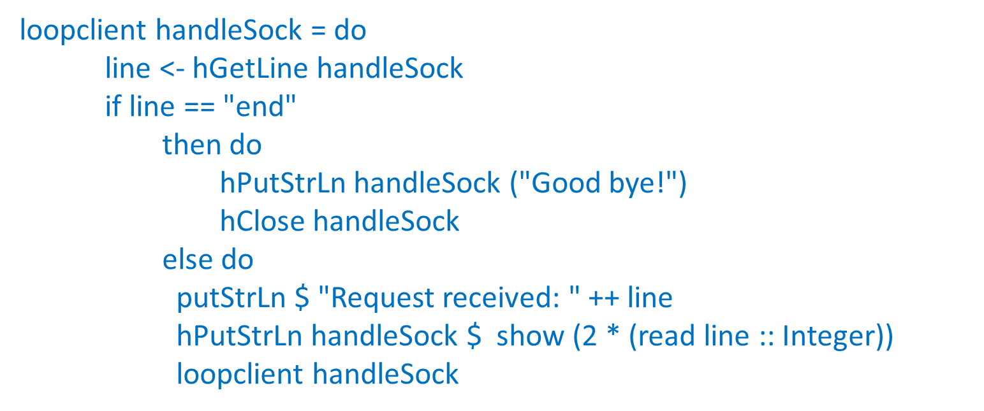
Client
n
2n
SERVER
Parallel and Concurrent Programming in Haskell · Simon Marlow

Slide 23

loopclient handleSock = do
line <- hGetLine handleSock
if line == "end"
then do
hPutStrLn handleSock ("Good bye!")
hClose handleSock
else do
putStrLn $ "Request received: " ++ line
hPutStrLn handleSock $ show (2 * (read line :: Integer))
loopclient handleSock
loopForever :: Socket -> IO ()
loopForever sock = do
(conn, _) <- accept sock
handleSock <- socketToHandle conn ReadWriteMode
line <- hGetLine handleSock
forkIO $ loopClient handleSock
loopForever sock
*Main> main
Listening on port 4250...
Request received: 2
Request received: 3
Request received: 3
Request received: 5
Request received: 6
Request received: a
<interactive>: Prelude.read: no parse
Request received: 8
C:\Users\igleu\nc>nc64 localhost 4250
2
4
3
6
3
6
8
16
C:\Users\igleu\nc>nc64 localhost 4250
5
10
6
12
a
C:\Users\igleu\nc>
exceptie
Este posibil ca handle-ul sa ramana deschis

Slide 24
loopForever :: Socket -> IO ()
loopForever sock = do
(conn, _) <- accept sock
handleSock <- socketToHandle conn ReadWriteMode
line <- hGetLine handleSock
forkFinally (loopClient handleSock) (\_ -> hClose handleSock)
loopForever sock
Exceptia este tratata folosind
forkFinally
*Main> main
Listening on port 4250...
Request received: 2
Request received: 3
Request received: 3
Request received: 5
Request received: 6
Request received: a
Request received: 8
C:\Users\igleu\nc>nc64 localhost 4250
2
4
3
6
3
6
8
16
C:\Users\igleu\nc>nc64 localhost 4250
5
10
6
12
a
C:\Users\igleu\nc>

Slide 25
Server cu stare partajata
"The new behavior is as follows: instead of multiplying each number by two, the server will multiply each number by the current factor. Any connected client can change the current factor by sending the command *N, where N is an integer. When a client changes the factor, the server sends a message to all the other connected clients informing them of the change.
While this seems like a small change in behavior, it introduces some interesting new challenges in designing the server.
There is a shared state—the current factor—so we must decide how to store it and how it is accessed and modified.
When one server thread changes the state in response to its client issuing the *N command, we must arrange to send a message to all the connected clients."
Parallel and Concurrent Programming in Haskell · Simon Marlow

Slide 26
Server cu stare partajata
Detalii de implementare:
Pentru fiecare conexiune (client) se creaza un thread nou in care se executa functia loopClient.
Functia loopClient creaza un canal de comunicare si executa in paralel o functiile server si receive.
Functia receive citeste comenzile clientului si le introduce in canalul de comunicare, de unde sunt citite si
prelucrate de functia server.
Functia server implementeaza actiunile serverului: citeste factorul initial, citeste si executa comenzile clientului;
comanda *N a clientului poate modifica valoarea factorului.
Pentru executarea in paralel a functiilor server si receive se foloseste functia race.
Functia race executa doua actiuni in parallel si o intoarce pe prima care se termina.

Slide 27
Memoria partajata este implementata in STM
TVar, TChan
comanda
writeTChan c line
memoria accesibila
tuturor clientilor
end
fiecare client are
propriul canal de
comunicare
factor :: TVar Int
2
34
*5
c :: TChan
(STM.TChan)
7
prelucreaza comanda

Slide 28
main = do
sock <- socket AF_INET Stream 0
setSocketOption sock ReuseAddr 1
bind sock (SockAddrInet 4000 0)
listen sock 2
putStrLn "Listening on port 4000..."
factor <- atomically $ newTVar 2
loopForever sock factor
import Network.Socket
import System.IO
import Control.Monad
import Control.Concurrent
import Control.Concurrent.STM
import Control.Concurrent.Async
loopForever :: Socket -> TVar Integer -> IO ()
loopForever sock factor = do
(conn, _) <- accept sock
handleSock <- socketToHandle conn ReadWriteMode
forkIO $ loopClient handleSock factor
loopForever sock factor

Slide 29

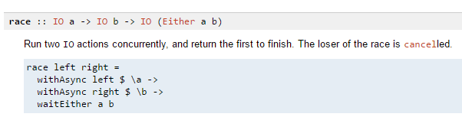
server2.hs
loopClient h f = do
c <- atomically newTChan
race_ (server h f c) (receive h c)
h :: Handle --propriu clientului
f :: TVar Integer -- factorul comun
c :: TChan String -- propriu clientului
se termina odata cu primul dintre server si receive
in aceasta implementare, server se termina cand primeste comanda end,
iar receive este o actiune definita cu forever

Slide 30
loopClient h f = do
c <- atomically newTChan
race_ (server h f c) (receive h c)
receive :: Handle -> TChan String -> IO ()
receive h c = forever $ do
line <- hGetLine h
atomically $ writeTChan c line
citeste datele/comenzile introduse de client
si le scrie pe canal
server :: Handle -> TVar Integer -> TChan String -> IO ()

Slide 31
server :: Handle -> TVar Integer -> TChan String -> IO ()
server h f c = do
fval <- atomically $ readTVar f --valoarea curenta a factorului
hPutStrLn h $ "Current factor is " ++ show fval --la inceputul interactiunii cu clientul
loop h fval f c
loop h fval f c = do
action <- atomically $ do
newval <- readTVar f
if (fval /= newval)
then return (newfactor h newval f c)
else do
line <- readTChan c
return (command h fval f c line)
action
newfactor -anunta clientului
modificarea factorului
command -executa comanda citita
de pe canalul clientului
ambele apeleaza recursiv loop

Slide 32
loop h fval f c = do
action <- atomically $ do
newval <- readTVar f
if (fval /= newval)
then return (newfactor h newval f c)
else do
line <- readTChan c
return (command h fval f c line)
action
newfactor h newval f c = do
hPutStrLn h $ "new factor:" ++ show newval
loop h newval f c
command h fval f c line = case line of
"end" -> do
hPutStrLn h ("Good bye!")
hClose h
'*':s -> do
putStrLn $ "Factor received: " ++ s
atomically $ writeTVar f (read s :: Integer)
loop h fval f c
_ -> do
putStrLn $ "Request received: " ++ line
hPutStrLn h $ show (fval * (read line :: Integer))
loop h fval f c

Slide 33
*Main> main
Listening on port 4252...
Request received: 3
Request received: 5
Factor received: 4
Request received: 5
Request received: 6
Factor received: 6
Request received: 8
Request received: 9
Request received: 5
Factor received: 10
Request received: 5
Request received: 6
Request received: 7
Factor received: 20
C:\Users\igleu\nc>nc64 localhost 4252
Current factor is 2
3
6
5
10
*4
new factor:4
new factor:6
5
30
new factor:10
6
60
new factor:20
C:\Users\igleu\nc>nc64 localhost 4252
Current factor is 4
5
20
6
24
*6
new factor:6
new factor:10
7
70
end
Good bye!
C:\Users\igleu\nc>nc64 localhost 4252
Current factor is 6
8
48
9
54
*10
new factor:10
5
50
*20
new factor:20

Slide 34
Server cu stare partajata si tip de data pentru clienti
client={nume, handle, canal}
server =[client]
Detalii de implementare:
Pentru fiecare conexiune se creaza un thread nou in care se executa functia createClient.
Functia createClient creaza un client nou, reprezentat printr-o structura {nume, handle, canal} si
apeleaza functia loopClient.
Fiecare client nou este anuntat celorlalti clienti.
Functia receive citeste comenzile clientului si le introduce in canalul de comunicare, de unde sunt citite si
prelucrate de functia server.
Functia loopClient executa in parallel functiile server si receive (folosind race).
Functia server implementeaza actiunile serverului: citeste factorul curent, citeste si executa comenzile clientului;
comanda *N a clientului poate modifica valoarea factorului .
Pentru executarea in paralel a functiilor server si receive se foloseste functia race.
Functia race executa doua actiuni in parallel si o intoarce pe prima care se termina

Slide 35
Server cu stare partajata si tip de date client
data Client = Client {cName :: String
,cHandle :: Handle
,cChan :: TChan String}
type Server = TVar [Client]
main = do
sock <- socket AF_INET Stream 0
setSocketOption sock ReuseAddr 1
bind sock (SockAddrInet 44445 0)
listen sock 2
putStrLn "Listening on port 44445..."
factor <- atomically $ newTVar 2
sv <- atomically $ newTVar [] -- serverul este lista clientilor, initial este []
loopForever sv sock factor

Slide 36
loopForever :: Server -> Socket -> TVar Integer -> IO ()
loopForever sv sock factor = do
(conn, _) <- accept sock
handleSock <- socketToHandle conn ReadWriteMode
forkFinally (createClient sv handleSock factor) (\_ -> hClose handleSock)
loopForever sv sock factor
createClient sv h f = do
hPutStrLn h "Name"
name <- hGetLine h
c <- atomically newTChan
putStrLn $ "New client: " ++ name
hPutStrLn h $ "Wellcome " ++ name
addClient sv name h c
loopClient h f c sv
loopClient h f c sv = race_ (server h f c sv) (receive h c)

Slide 37
addClient sv name h c = atomically $ do
svclients <- readTVar sv
writeTVar sv (svclients ++ [(Client name h c)])
broadcast svclients ("@"++ name)
broadcast [] msg = return ()
broadcast ((Client _ _ c):lcl) msg = do
writeTChan c msg
broadcast lcl msg
pentru a transmite celorlalti client numele noului client,
pe canalul fiecarui client deja existent este pusa o comanda speciala
aceasta comanda va fi prelucrata in functia command

Slide 38
loopClient h f c sv = race_ (server h f c sv) (receive h c)
server :: Handle -> TVar Integer -> TChan String -> Server -> IO ()
server h f c sv = do
fval <- atomically $ readTVar f
hPutStrLn h $ "Current factor is " ++ show fval
loop h fval f c sv
loop h fval f c sv = ...
newfactor h newval f c sv = …
command h fval f c line sv = …
receive :: Handle -> TChan String -> IO ()
receive h c = forever $ do
line <- hGetLine h
atomically $ writeTChan c line

Slide 39
command h fval f c line sv = case line of
"end" -> do
hPutStrLn h ("Good bye!")
hClose h
'*':s -> do
putStrLn $ "Factor received: " ++ s
atomically $ writeTVar f (read s :: Integer)
loop h fval f c sv
'@':s -> do
hPutStrLn h $ "New client: " ++ s
loop h fval f c sv
_ -> do
putStrLn $ "Request received: " ++ line
hPutStrLn h $ show (fval * (read line :: Integer))
loop h fval f c sv

Slide 40
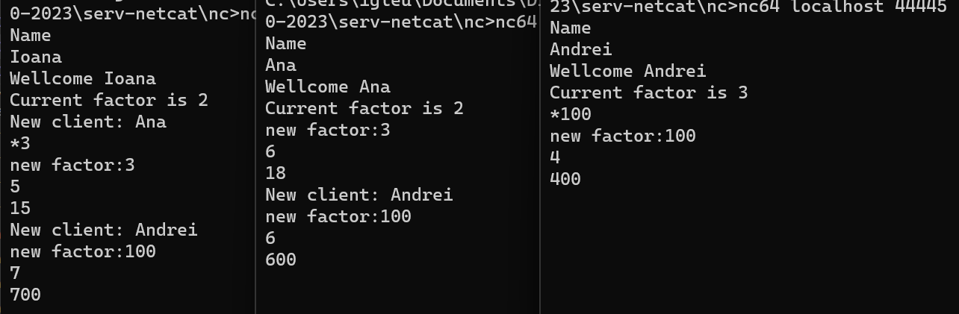
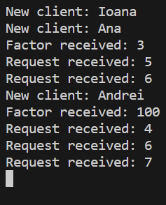

Slide 41
Pentru fiecare client adaugam o comanda ">nume" care transmite "Hugs!" clientului "nume"
command h fval f c line sv = case line of
"end" -> do
hPutStrLn h ("Good bye!")
hClose h
'*':s -> do
putStrLn $ "Factor received: " ++ s
atomically $ writeTVar f (read s :: Integer)
loop h fval f c sv
'@':s -> do
hPutStrLn h $ "New client: " ++ s
loop h fval f c sv
'>':s -> do
sendmessageto s sv
loop h fval f c sv
"<" -> do
hPutStrLn h "Hugs!"
loop h fval f c sv
_ -> do
transmiterea mesajului catre clientul cu numele s
prelucrarea mesajului primit de la alt client

Slide 42

Pentru fiecare client adaugam o comanda ">nume" care transmite "Hugs!" clientului "nume"
command h fval f c line sv = case line of
"end" -> do
hPutStrLn h ("Good bye!")
hClose h
'*':s -> do
putStrLn $ "Factor received: " ++ s
atomically $ writeTVar f (read s :: Integer)
loop h fval f c sv
'@':s -> do
hPutStrLn h $ "New client: " ++ s
loop h fval f c sv
'>':s -> do
sendmessageto s sv
loop h fval f c sv
"<" -> do
hPutStrLn h "Hugs!"
loop h fval f c sv
_ -> do
transmiterea mesajului catre clientul cu numele s
sendmessageto s sv = atomically $ do
svclients <- readTVar sv
let c = channelof s svclients
writeTChan c "<"
channelof s ((Client n _ c):lcl) = if s==n
then c
else (channelof s lcl)

Slide 43
*Main> main
Listening on port 4255...
New client: Ioana
Request received: 3
New client: Ana
Request received: 6
Factor received: 10
Request received: 5
New client: Andrei
Request received: 5
Factor received: 3
Request received: 4
C:\Users\igleu\nc>nc64 localhost 4255
Name
Ioana
Wellcome Ioana
Current factor is 2
3
6
New client: Ana
new factor:10
New client: Andrei
new factor:3
4
12
>Ana
end
Good bye!
C:\Users\igleu\nc>nc64 localhost 4255
Name
Ana
Wellcome Ana
Current factor is 2
6
12
*10
new factor:10
5
50
New client: Andrei
Hugs!
Hugs!
>Andrei
new factor:3
Hugs!
C:\Users\igleu\nc>nc64 localhost 4255
Name
Andrei
Wellcome Andrei
Current factor is 10
5
50
>Ana
>Ana
Hugs!
*3
new factor:3

Slide 44
http://community.haskell.org/~simonmar/slides/cadarache2012/5%20-%20server%20apps.pdf

